Slide 1
Containerization and Orchestration - An Overview
Application Frameworks (SE3040)
Vishan Jayasinghearachchi Lecturer
Department of Software Engineering, Faculty of Computing
vishan.j@sliit.lk

Slide 2
Learning Objectives
After completing this lecture, you will be able to,
Describe two main virtualization technologies (Hardware/ Operating System) available in the computing domain.
Describe what containerization is and the need for it.
Analyze a scenario to identify which virtualization technologies such as virtual machines and containerization are applicable to the given scenario.

Slide 3
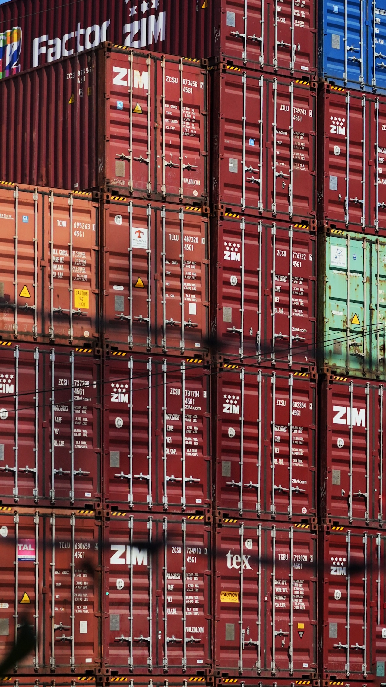
Contents
Traditional Application Deployment
Cloud Native Applications
Microservices Architecture
Containers
VMs vs Containers
Containers: Underlying Technology
Docker Overview
Container Orchestration
Kubernetes Overview

Slide 4
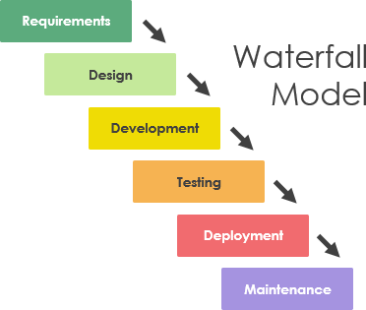
Traditional Application Deployment
Capacity Planning
Source: https://www.visual-paradigm.com/guide/software-development-process/what-is-a-software-process-model/

Slide 5
Traditional Application Deployment
Capacity Planning
Estimate the required amount computational resources to deploy the developed application and purchase them.
An expensive operation.
Involves guesswork.
A video on this.

Slide 6
Cloud Native Applications
With the introduction of cloud computing, users were provided with the ability to simply utilize virtualized hardware on cloud platforms such as VMs instead of actual hardware.
However, it was not possible to take full advantage of the flexibility provided by the Cloud with the traditional application development architectures and practices.

Slide 7
Cloud Native Applications
Cloud Native Applications to the rescue!
Cloud native architecture is an innovative software development approach that is specially designed to fully leverage the cloud computing model.

Slide 8
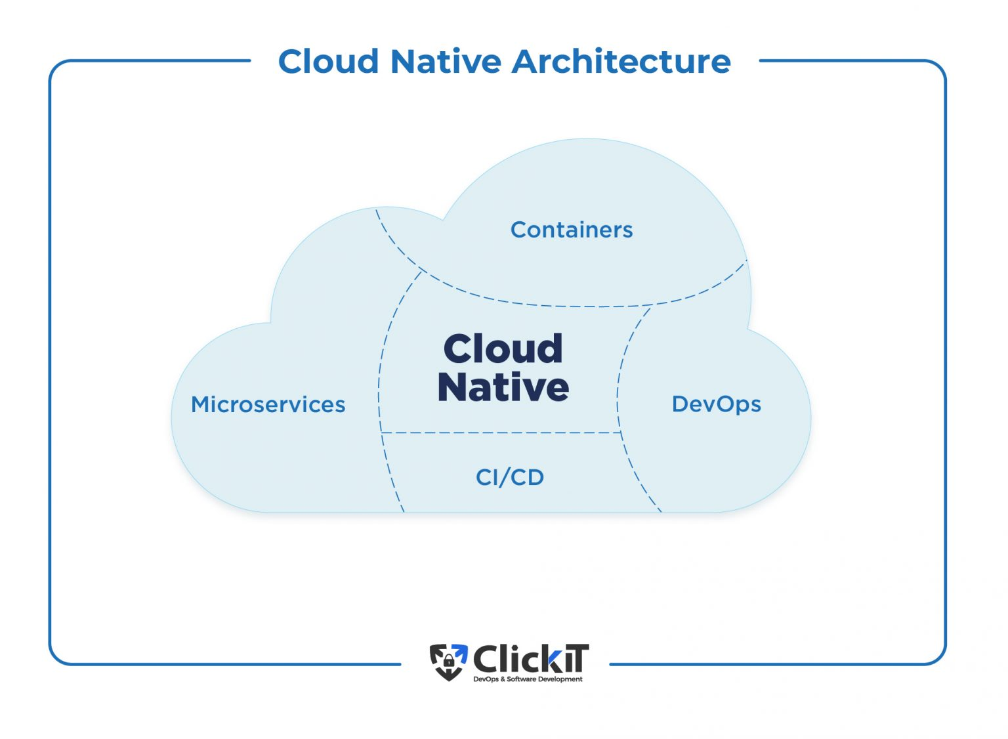
Cloud Native Applications
Source: https://www.clickittech.com/devops/cloud-native-architecture/

Slide 9
Microservices Architecture
What are Microservices?
“Microservices architecture is an approach in which a single application is composed of many loosely coupled and independently deployable smaller services.” (Source – IBM)

Slide 10
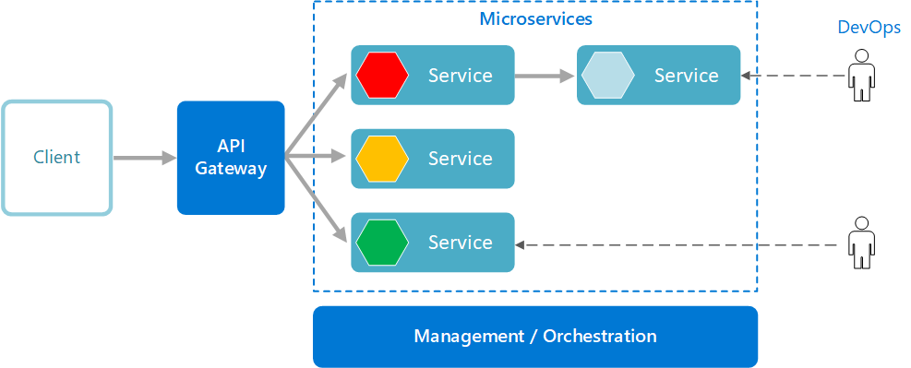
Microservices Architecture
Source: https://learn.microsoft.com/en-us/azure/architecture/microservices/

Slide 11
Microservices Architecture
Characteristics of Microservices
Have their own technology stack and typically means of managing data as well (Databases etc.).
Communicate with each other using APIs, Message Brokers and event streaming.
Organized by the business capability (bounded context) and not as horizontal layers such as data access, messaging etc.
Services are loosely coupled, highly functionally cohesive and independent.

Slide 12
Microservices Architecture
Benefits of Microservices
Each microservice could be developed and deployed independent of other services.
Because of this independence, the development team could use the most suitable technology stack for each service, rather than depending on an agreed set of tools for all services (Polyglot programming).
Precise scaling - each component of the application could be scaled independently of others, increasing the resource usage efficiency.

Slide 13
Microservices Architecture
Read more on Microservices
Martin Fowler – Microservices
Microservices.io reference

Slide 14
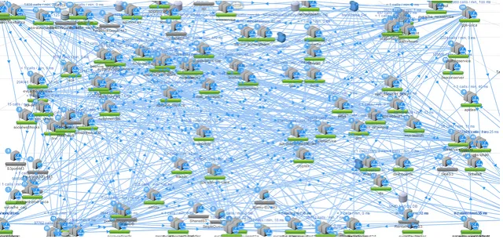
Microservices Architecture
Q: Microservices is just an architecture. How is this architecture implemented?
Source: https://netflixtechblog.com/announcing-ribbon-tying-the-netflix-mid-tier-services-together-a89346910a62

Slide 15
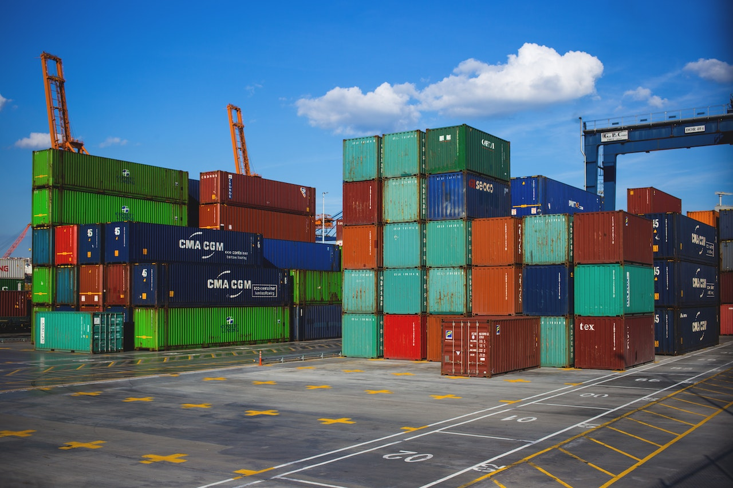
Containers
Containers are a very popular approach for implementing Microservices Architectures.

Slide 16
Containers
What is a container?
A Container is a package of software that contain all the necessary elements of a software (binaries, libraries, files, configurations etc.) in a single lightweight executable which runs consistently on any infrastructure.

Slide 17

Before Containers

Slide 18
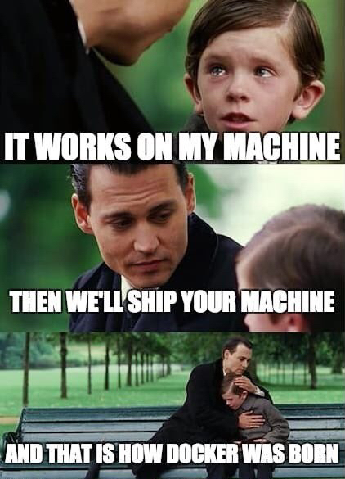
After Containers

Slide 19
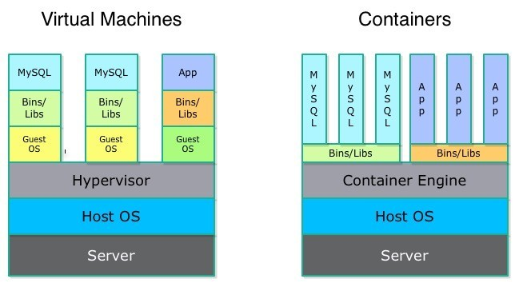
Virtual Machines vs Containers
Why is it containers, why not VMs?
Source: https://msystechnologies.com/wp-content/uploads/2015/10/cloud-container-blog-1.jpg

Slide 20
Virtual Machines vs Containers
Containerization introduction: watch this video.
When to use which? watch this video.
To summarize,
virtual machines provide Hardware (H/W) level virtualization.
Containers provide Operating System (O/S) level virtualization.

Slide 21
Containers
Why choose containers?
Traditionally, code was developed in an environment with specific configurations, outside of which the application is not guaranteed to perform as expected.
Containerization eliminates this problem by bundling the application code together with the related configuration files, libraries, and dependencies required for it to run.

Slide 22
Containers
Why choose containers?
This single package of software or “container” is abstracted away from the host operating system hence, it stands alone and becomes portable—able to run across any platform or cloud, free of issues.
Containers are ‘lightweight’ (compared to VMs) – they share the machine’s operating system kernel (therefore, resource efficient and faster).
Containerization allows applications to be “written once and run anywhere.”

Slide 23
Microservices in containers
A microservice, developed within a container, gains the inherent benefits of containerization;
Portability and no vendor lock-in
Developer agility
Fault isolation
Efficient resource utilization
Automation of installation, scaling and management
More layers of security

Slide 24
Containers – Underlying technology
Two Linux concepts - cgroups and namespaces together form the basis of containerization technologies.
Namespaces provide process isolation, allowing process/es to run independently of each other and the host system.
Cgroups provide resource management and isolation for a collection of processes (i.e. a namespace), ensuring that these processes do not consume excessive resources.
This video discusses these two concepts briefly.

Slide 25
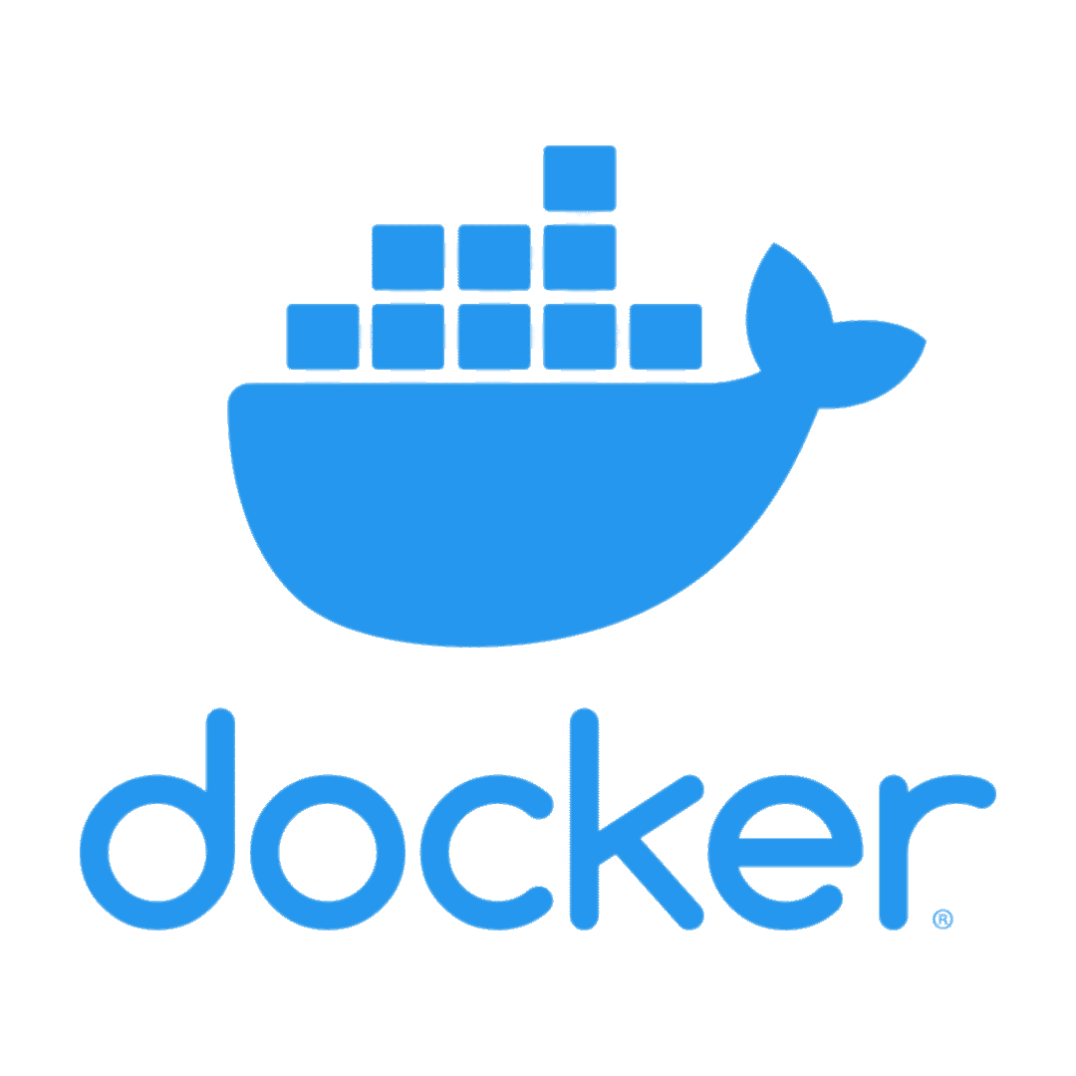
Docker Overview
Docker is the current Industry standard for containerization.
Docker introduction: watch this video.

Slide 26
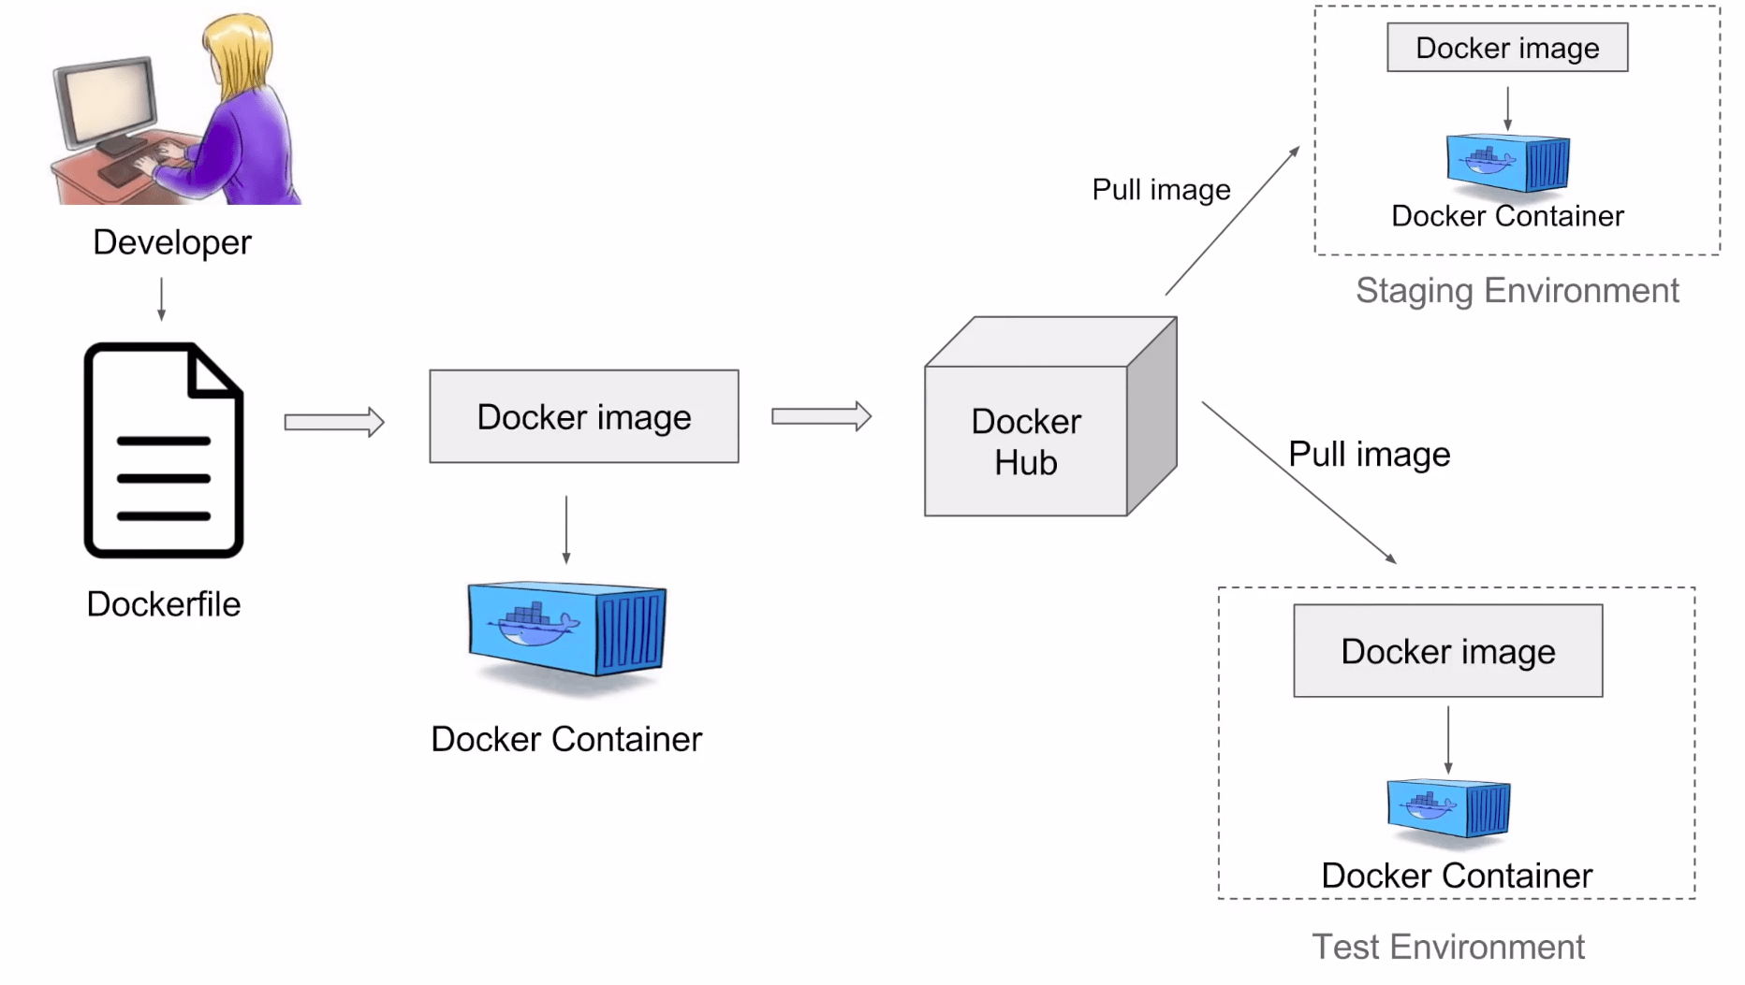
Docker Overview
Source: https://k21academy.com/docker-kubernetes/docker-and-kubernetes/

Slide 27

Container Orchestration
Container orchestration is comparable to the role of the conductor of an orchestra.
Source: https://www.musicgateway.com/blog/music-theory/music-conductor

Slide 28
Container Orchestration
Why is it needed?
In small numbers, one can manually deploy and manage containers.
But what would happen in an enterprise scenario, where millions of customers are constantly requesting for different types of services? Eg: Google search?
It is impossible to handle this load manually. Automation is needed.
Container Orchestration is the solution.

Slide 29
Container Orchestration
How does it work?
Usually, a developer writes a configuration file which is understood by the Orchestration tool.
This configuration file defines the desired state the containerized application (i.e. the containers which make it up) should be in.
The orchestration tool, based on this configuration file, maintains the state of the containers to resemble the desired state.
It manages the deployment of the containers, resiliency, selection of the host (to deploy the containers).
Once deployed, it manages scalability, availability and performance and even collecting and logging data for later review.

Slide 30
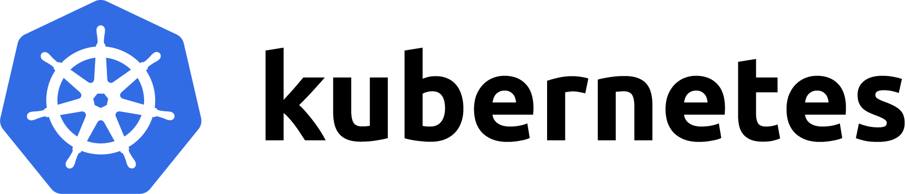
Kubernetes Overview
Kubernetes is the current Industry standard for container orchestration.
Kubernetes quick intro: watch this video.
Kubernetes in 5 mins: watch this video.

Slide 31
Summary
Traditional Application Deployment
Cloud Native Applications
Microservices Architecture
Containers
Container Orchestration
Current Industry Standards

Slide 32
Acknowledgements and Additional Reading
What is Cloud Native Architecture?
What is DevOps?
What Are CI/CD and the CI/CD Pipeline?
Containerization explained.
What are Microservices?
What is Container Orchestration?

